Slide 1
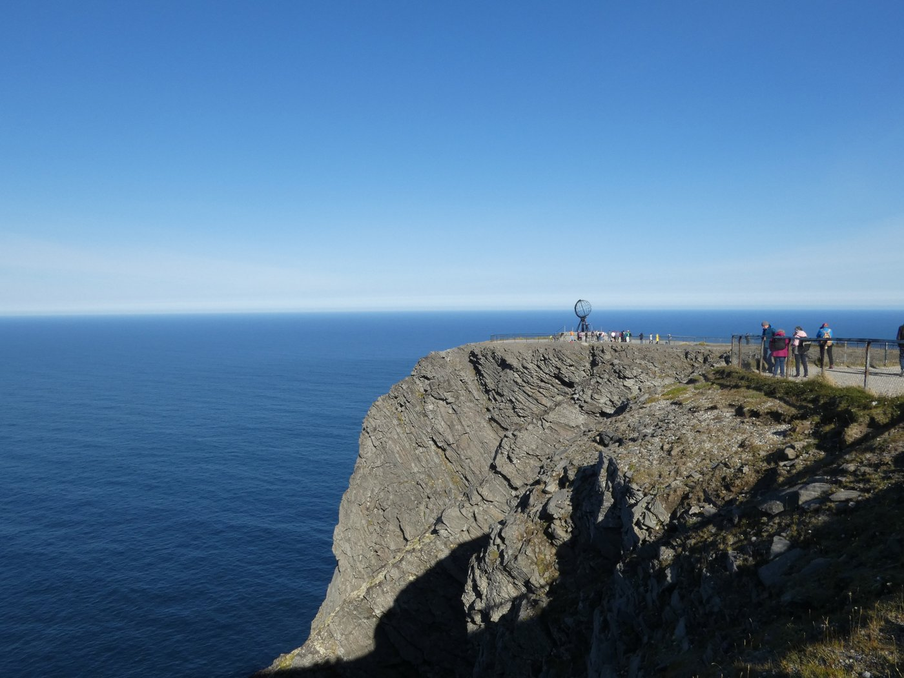
THE COASTAL EXPRESS
Highlights of the 12-Day Roundtrip Voyage
12 Days
34 Unique Ports • 2,500 Nautical Miles

Slide 2
Voyage at a Glance
A roundtrip journey along Norway's coast, from art-nouveau cities to the Arctic Circle and back.
1
2
3
12 Days
34 Ports
2,500 Nautical Miles
Total Duration
Unique Port Calls
Distance Covered
Route Overview
Northbound: Sailing north through Ålesund, crossing the Arctic Circle, past the North Cape, and on to Kirkenes near the Russian border.
Southbound: Returning via Hammerfest, the Lofoten Islands, Trondheim, and Norway's coastal kitchen.

Slide 3
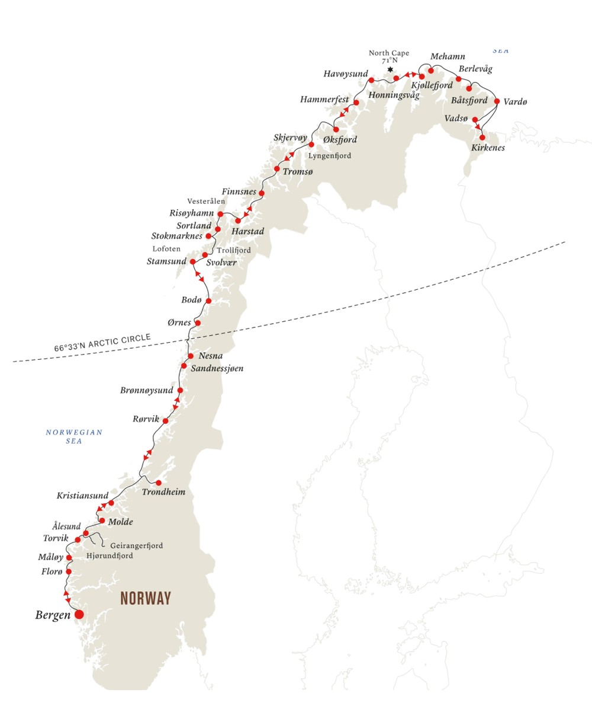
THE FULL ROUTE
Bergen to Kirkenes — and Back
The classic Hurtigruten coastal route: 34 ports each way, turning back at Kirkenes in the far northeast, just a few kilometers from the Russian border.

Slide 4
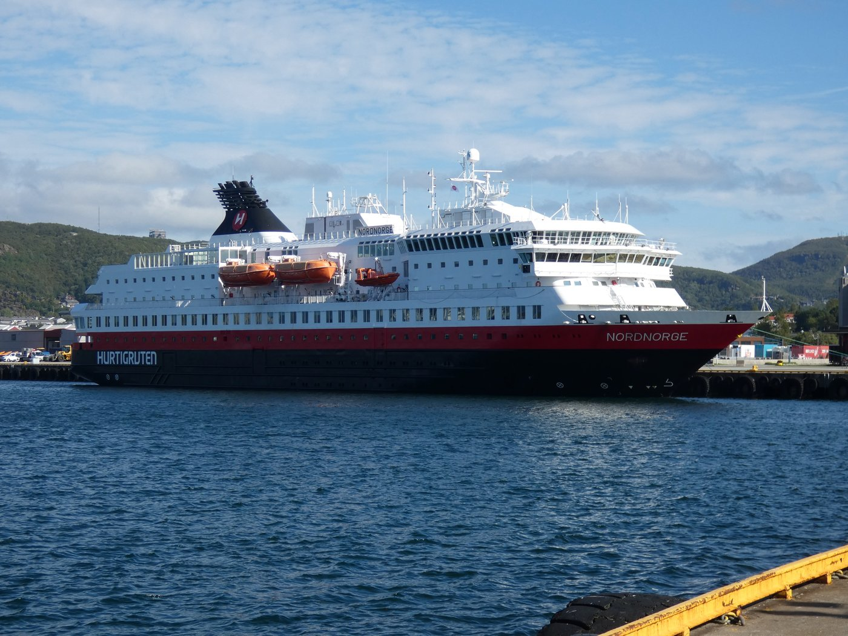
OUR SHIP
Aboard the MS Nordnorge
The Hurtigruten ship MS Nordnorge carried us the full length of this roundtrip voyage, calling at ports both large and small along Norway's dramatic coastline. A working coastal ferry as much as a cruise ship, it's the classic way to experience Norway from the water.
Hurtigruten Fleet

Slide 5
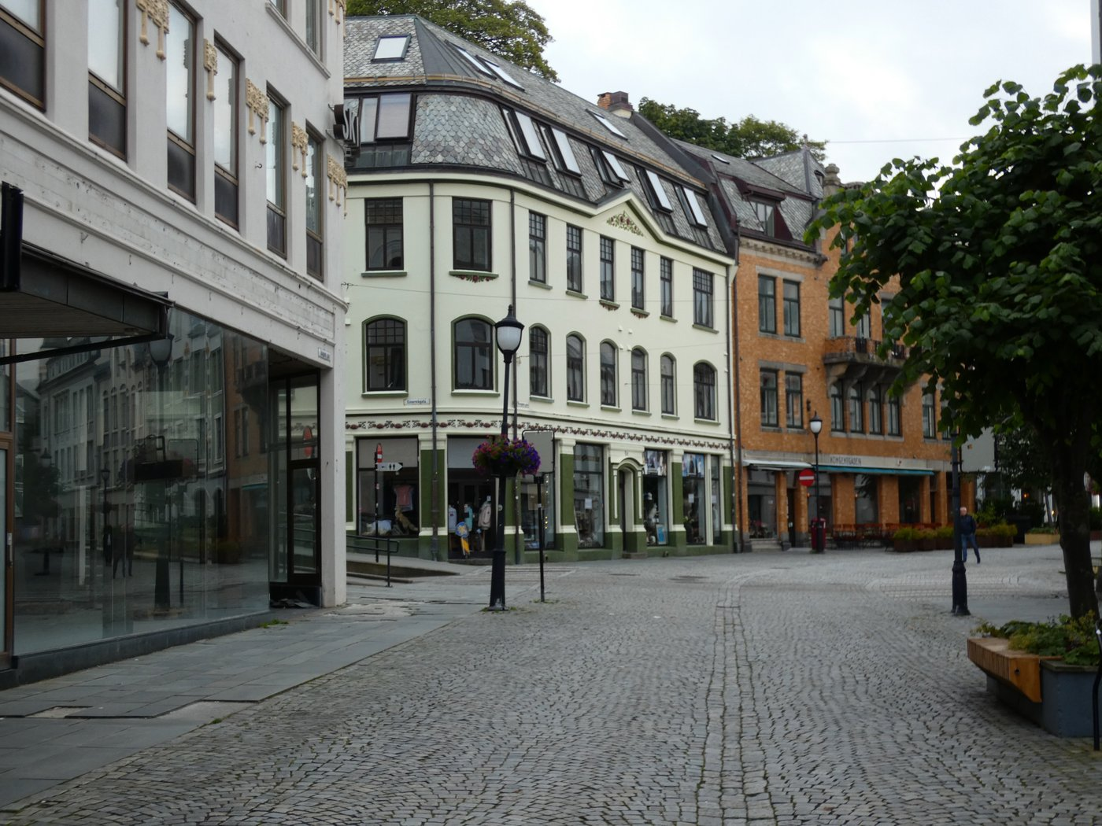
NORTHBOUND · REACHING THE TOP OF THE WORLD
Art Nouveau Ålesund
The first stop north showcases Ålesund's striking Art Nouveau architecture — elegant facades and ornate details throughout a city that was entirely rebuilt in this style after a devastating fire in 1904. Wandering its cobbled streets and squares feels like stepping into a different era.
Historic Rebuild

Slide 6
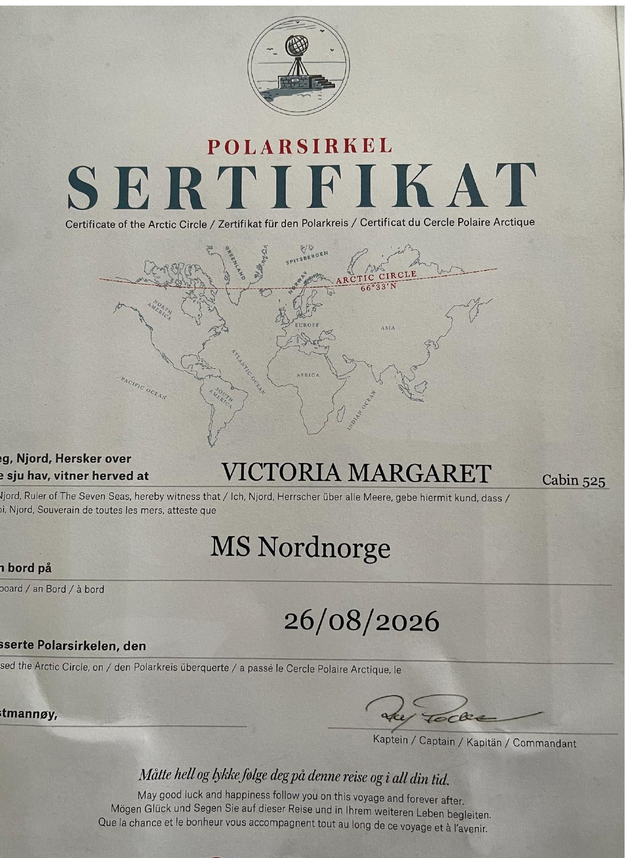
NORTHBOUND · REACHING THE TOP OF THE WORLD
Crossing the Arctic Circle
One of the voyage's most memorable moments: crossing 66°33' N, the symbolic threshold of the Arctic. The occasion was marked with a traditional Polar Circle certificate, presented onboard the MS Nordnorge — a custom sailors have observed for generations.
66° 33' N

Slide 7
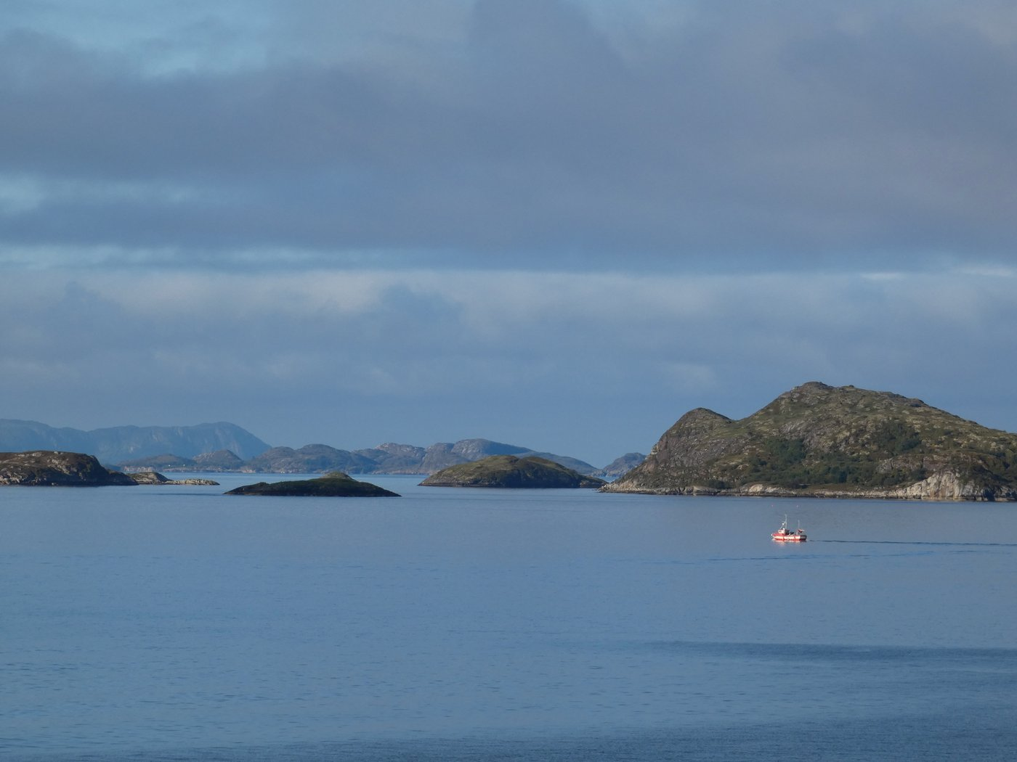
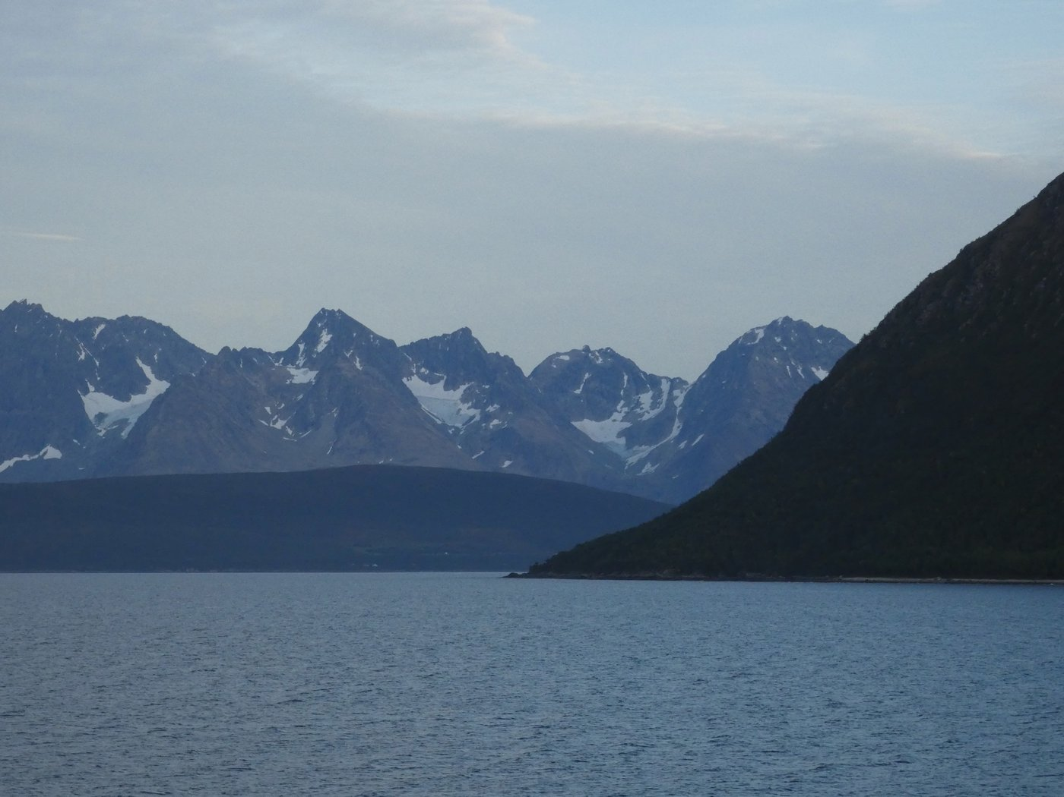
NORTHBOUND · REACHING THE TOP OF THE WORLD
Cruising Norway's Wild Coastline
Between ports, the voyage unfolds through scattered skerries, fishing boats, and snow-capped peaks rising straight from the water — scenery that changes by the hour as the ship threads its way north.
Skerries along the coastal route
Snow-capped peaks near the Arctic

Slide 8
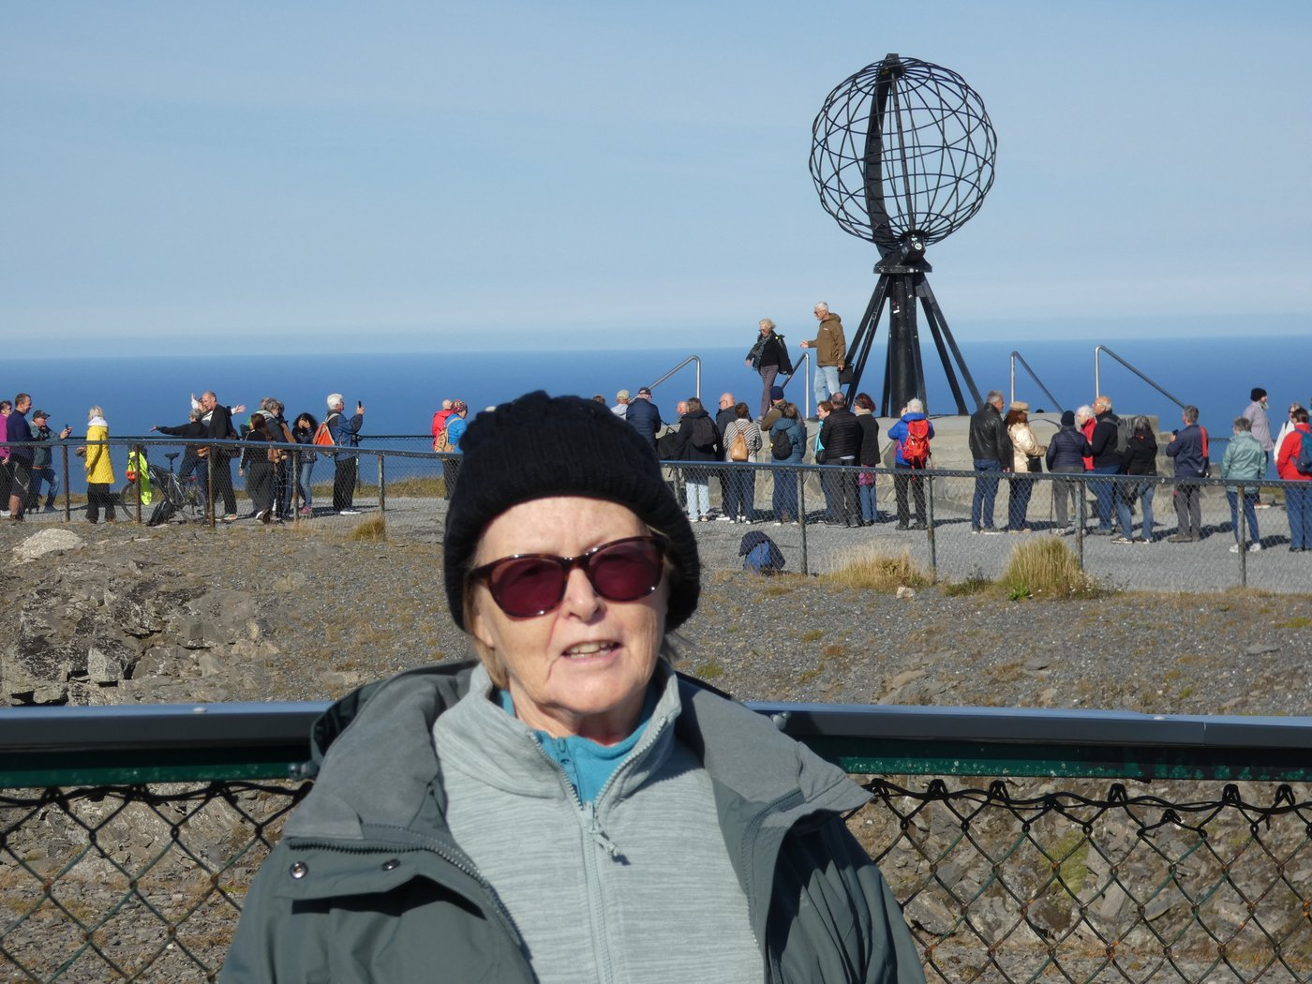
NORTHBOUND · REACHING THE TOP OF THE WORLD
Standing at the North Cape
At Europe's northernmost point, a 307-meter plateau drops sheer into the Arctic Ocean. The iconic globe monument marks the spot where the cliffs meet open sea — one of the trip's true bucket-list moments, and a striking place to pause for a photo.
307m Plateau

Slide 9
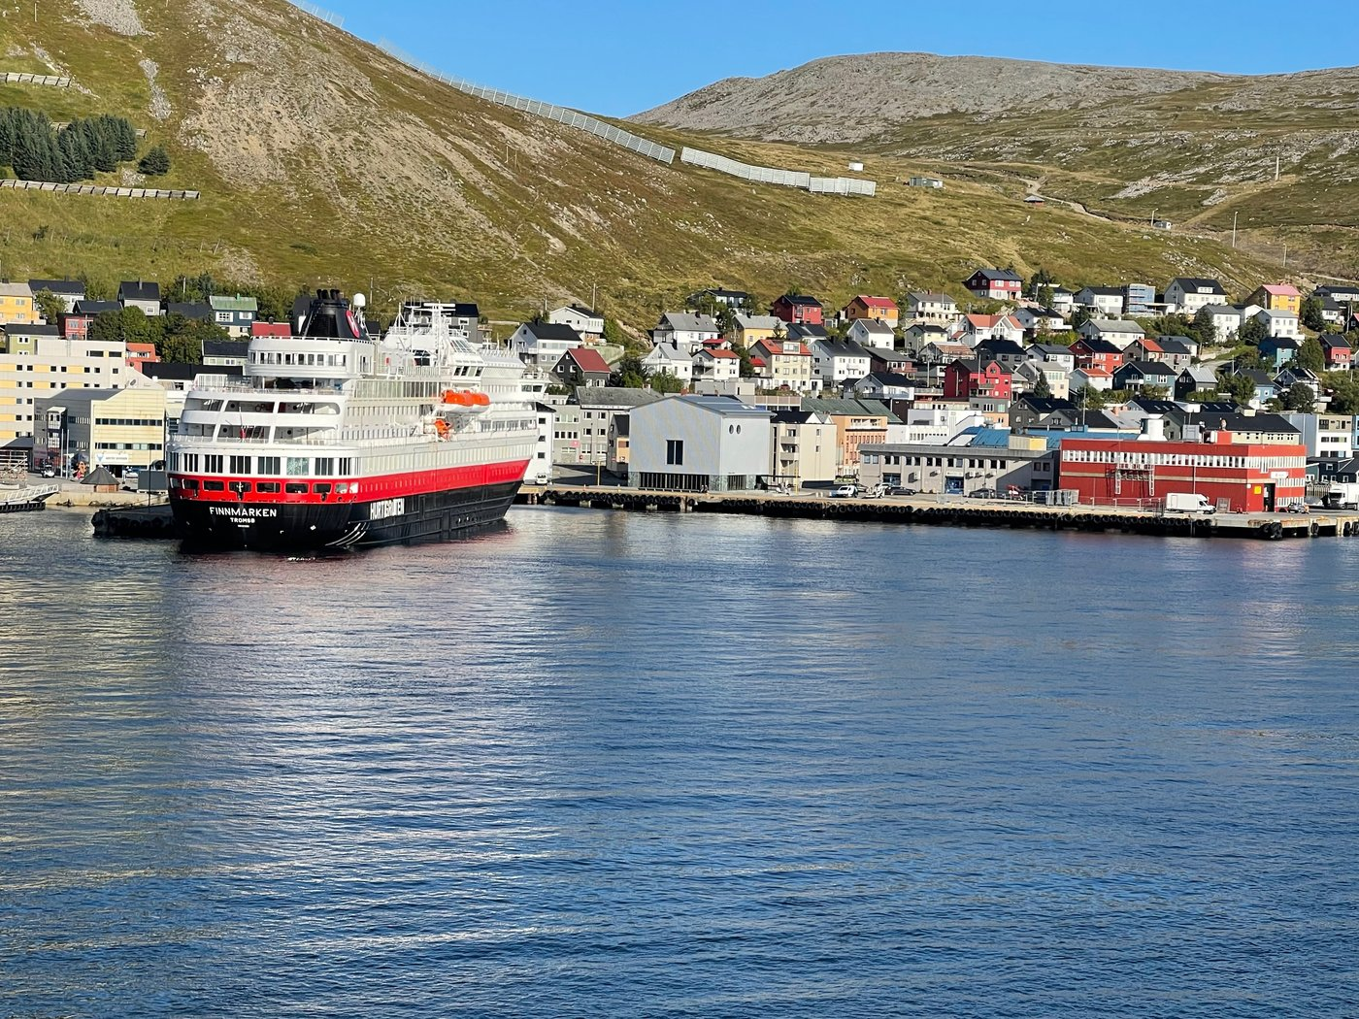
NORTHBOUND · REACHING THE TOP OF THE WORLD
Honningsvåg: Gateway to the Cape
The ship docks at Honningsvåg, a small, colorful harbor town and the launch point for excursions to the North Cape. It's a classic Arctic port — bright houses climbing the hillside above a working harbor at the top of the world.
Port of Call

Slide 10
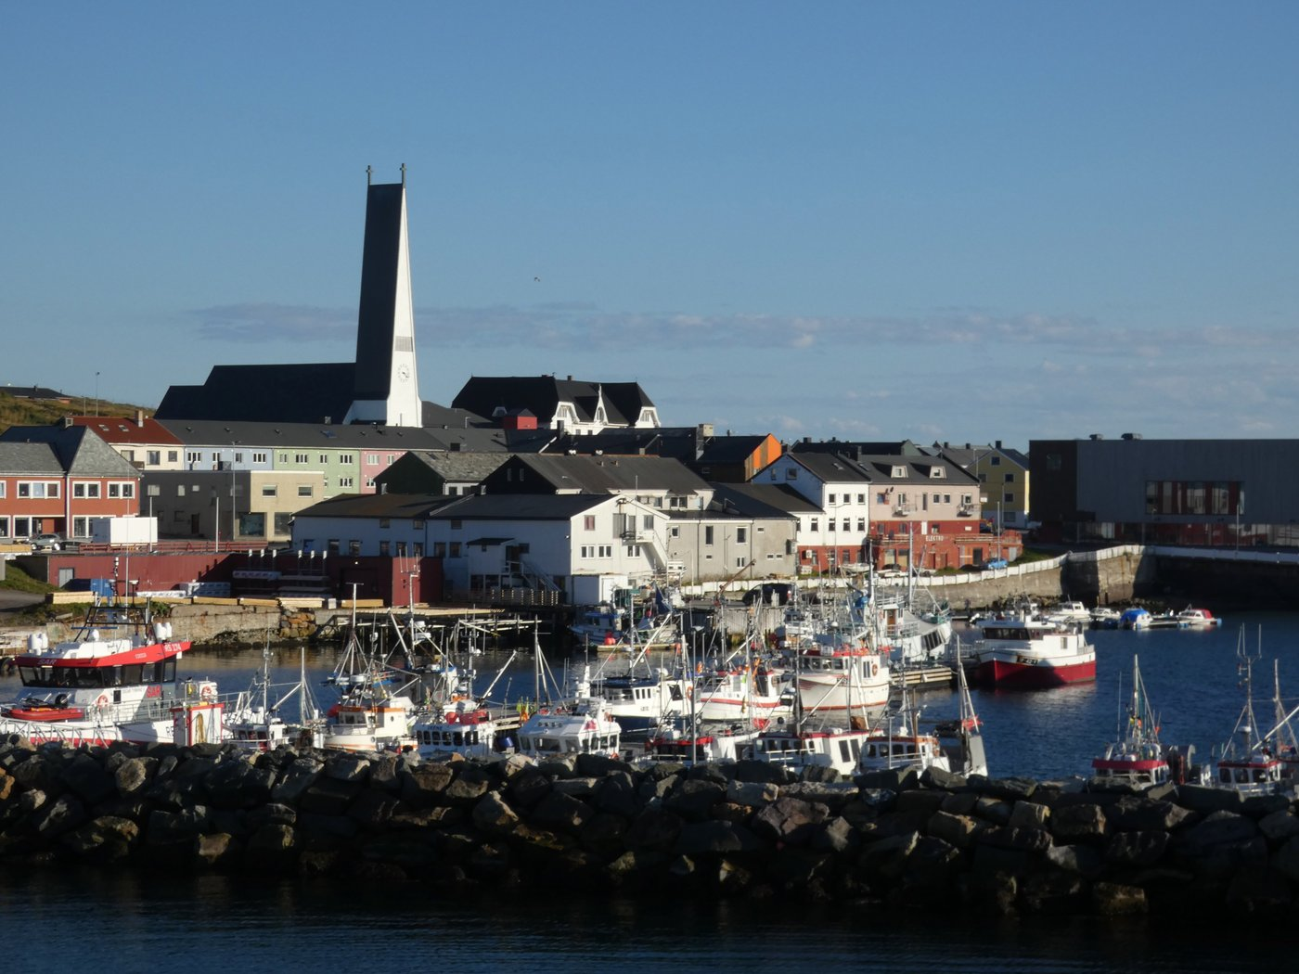
NORTHBOUND · REACHING THE TOP OF THE WORLD
Hammerfest: World's Northernmost Town
Tucked into the hillside at the top of Norway, Hammerfest is one of the world's northernmost towns of its size. Colorful houses climb the slopes above the harbor, where the ship docks alongside the daily rhythm of a genuine Arctic fishing community.
Arctic Norway

Slide 11
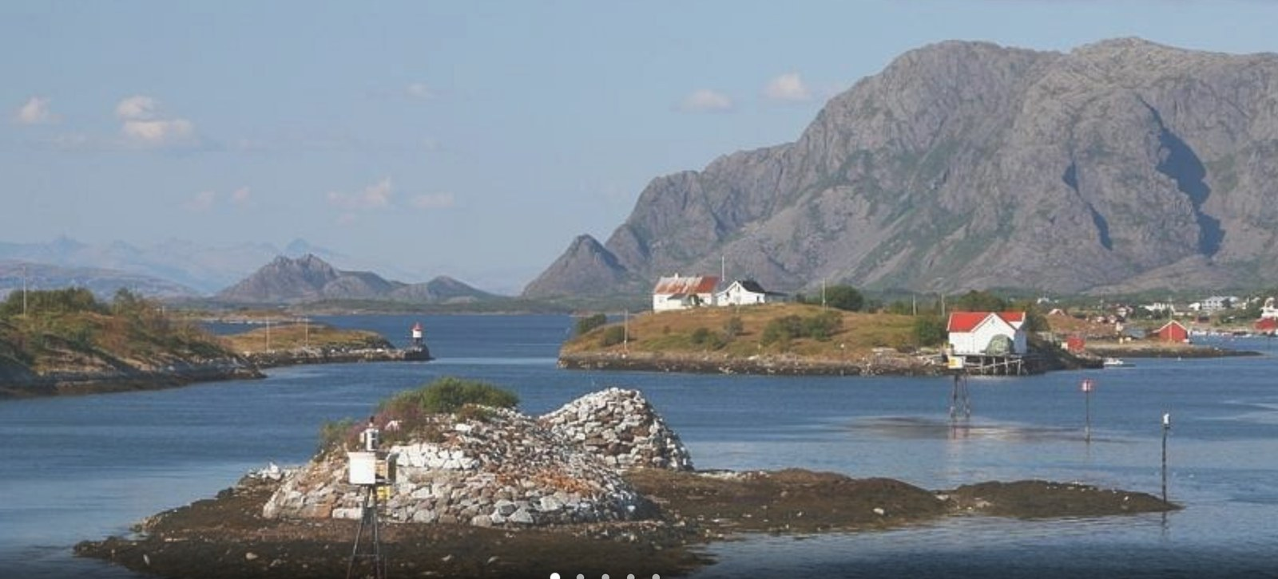
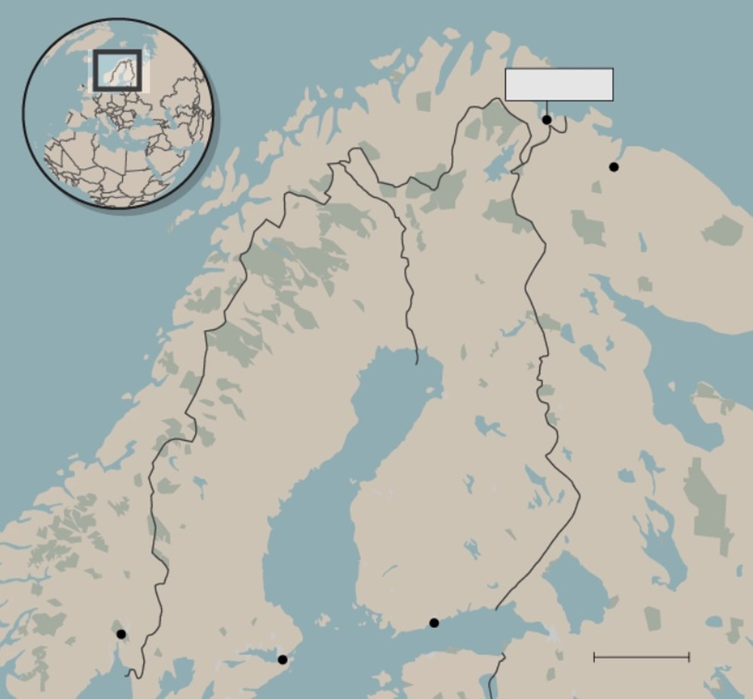
THE TURNING POINT
Kirkenes: Journey's Far Edge
The voyage's easternmost point, Kirkenes lies just a few kilometers from the Russian border — closer to Murmansk than to Oslo. It's here, among quiet skerries and fishing harbors, that the ship turns around and begins the journey back south.
The harbor at Kirkenes
Norway's border with Russia, near Kirkenes

Slide 12
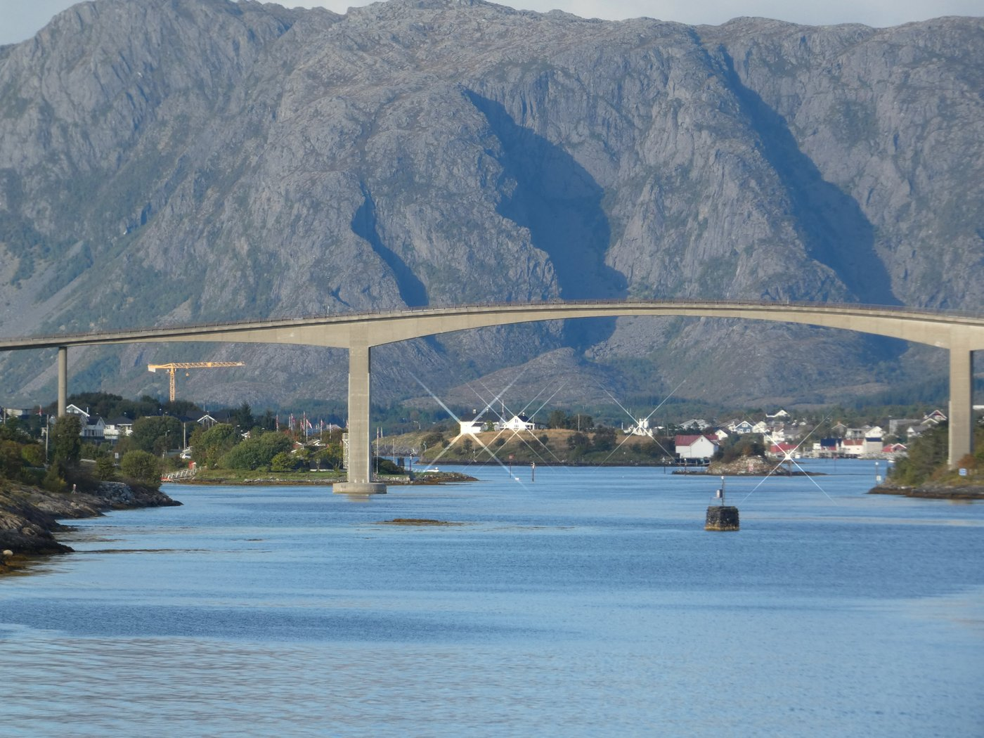
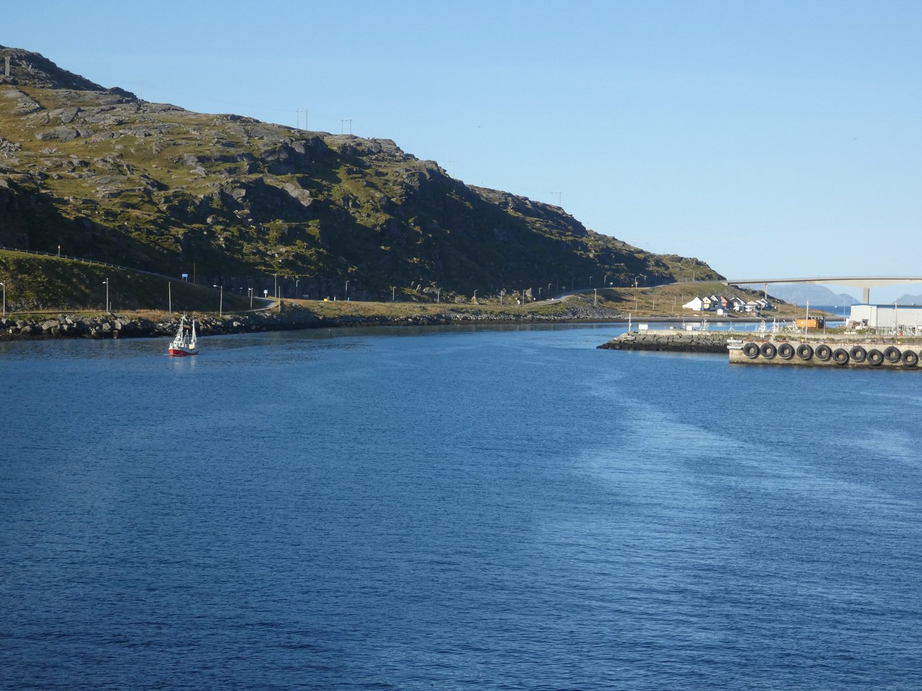
SOUTHBOUND · COASTAL HERITAGE AND FLAVORS
The Lofoten Wall and Its Bridges
Heading south, the ship sails beneath the jagged peaks of the Lofoten Wall, where sweeping bridges link the scattered islands and mountains rise directly from the fjords — some of Norway's most dramatic scenery.
Lofoten's mountains and bridges
Crossing the coastal route

Slide 13
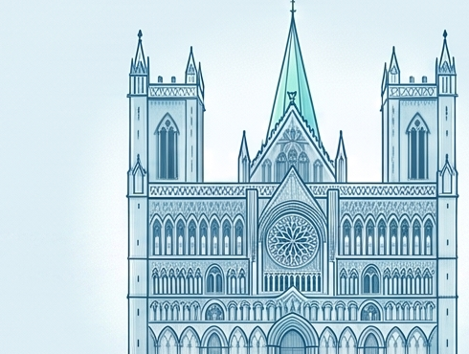
SOUTHBOUND · COASTAL HERITAGE AND FLAVORS
Trondheim's Gothic Masterpiece
A visit to Nidaros Cathedral, Norway's sacred heart and national shrine, founded in 1070. Its soaring Gothic facade and intricate stonework make it one of Scandinavia's most significant religious and historic landmarks.
Founded 1070

Slide 14
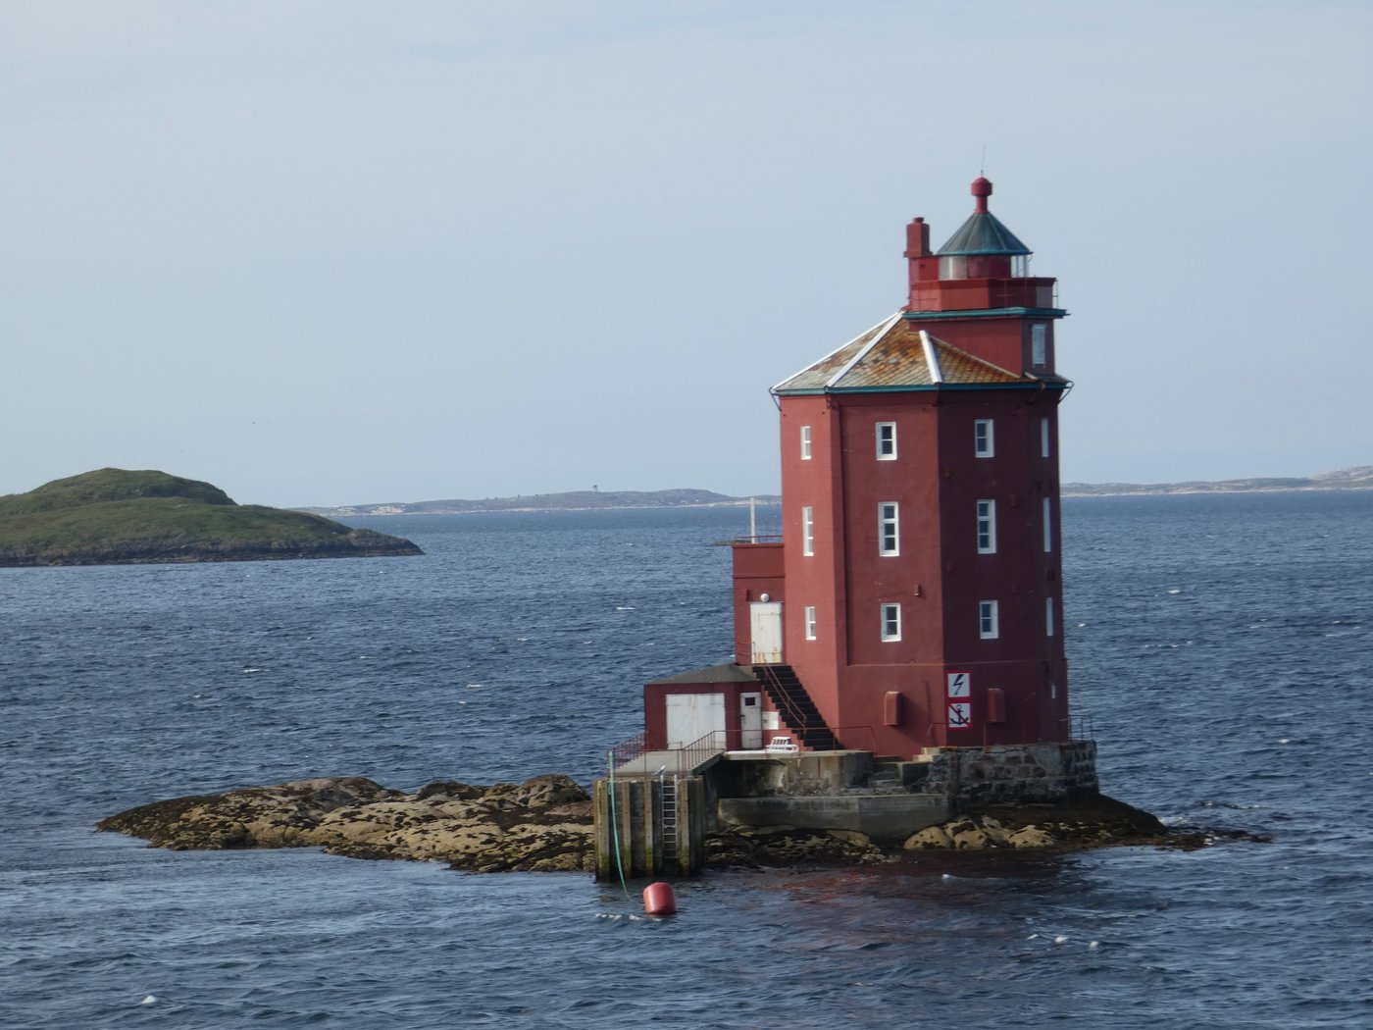
SOUTHBOUND · COASTAL HERITAGE AND FLAVORS
A Coastal Beacon
Scattered along Norway's coast, distinctive red lighthouses like this one have guided ships through narrow channels and skerries for generations — a quiet, enduring symbol of the maritime life this whole voyage is built around.
Guiding the Way

Slide 15

SOUTHBOUND · COASTAL HERITAGE AND FLAVORS
Norwegian Folklore: Trolls
No Norwegian journey is complete without a brush with its folklore. Troll statues like these greet travelers along the route, a playful nod to the legends of mountain-dwelling creatures said to roam Norway's remote fjords and forests.
Local Legend

Slide 16

SOUTHBOUND · COASTAL HERITAGE AND FLAVORS
Norway's Coastal Kitchen
The voyage's flavors are as memorable as its views. Fresh, local ingredients — king crab and Arctic char among them — are delivered straight to the ship, offering a true taste of the Norwegian coastline at every meal.
Fresh & Local

Slide 17
A Journey From Fjord to Arctic — and Back
12 days. 34 ports. 2,500 nautical miles.
From Art Nouveau facades to the Arctic Circle, the Lofoten Wall, and Norway's coastal kitchen.

